Slide 1

8th Grade Math: Pre-Algebra
Unit 9, Lesson 1 Slides, Flips, and Spins Volume 2, pg. 57

Slide 2


Benchmark
MA.8.GR.2.1
Given a preimage and image generated by a single transformation, identify the transformation that describes the relationship.
volume 2, pg. 57

Slide 3
Integrated Mathematical Thinking and Reasoning Standards
MA.K12.MTR.1.1 Actively participate in effortful learning both individually and collectively.
MA.K12.MTR.2.1 Demonstrate understanding by representing problems in multiple ways.
MA.K12.MTR.4.1 Engage in discussions that reflect on the mathematical thinking of self and others.
volume 2, pg. 57

Slide 4

Learning Targets
I can show the mapping of a preimage to an image.
I can describe relationships between figures after a slide, flip, or spin.
volume 2, pg. 57

Slide 5

Warm-Up
volume 2, pg. 57

Slide 6
9.1.1 Warm-Up: Nutritionist
Sasha Bard is a registered dietitian nutritionist who works for the U.S. Department of Agriculture. A nutritionist, or dietitian, is an expert in food, health, and nutrition. Nutritionists are health professionals, so they work in a variety of settings. They work in hospitals helping patients, in grocery stores helping customers, and in gyms to help athletes perform their best.
What is something that surprised you about what a nutritionist does?
volume 2, pg. 57

Slide 7
Sasha recommends that students who may be interested in pursuing this field should get out and volunteer at a food pantry or soup kitchen.
How do you think volunteering at a food pantry or soup kitchen would be helpful for someone interested in being a nutritionist?
volume 2, pg. 57

Slide 8

Collaboration
volume 2, pg. 58

Slide 9


9.1.2 Collaboration: Describing Movements
Felix is using palm tree wallpaper squares to create a design on his wall. He experiments with different movements by sliding, flipping, and spinning squares like the one shown.
For each movement shown in the table, identify the description of the movement Felix used.
Movement |  | Description
A |  | slide flip spin
3
3
volume 2, pg. 58

Slide 10
Compare your responses with your partner and resolve any differences.
Movement |  | Description
B |  | slide flip spin
C |  | slide flip spin
3
3
3
3
volume 2, pg. 58

Slide 11

Choose one of the movements and describe how you determined its type.
I determined movement showed a
because…
Describe which type(s) of movements you think Felix used to create the design shown.
A
B
C
slide
flip
spin
volume 2, pg. 58

Slide 12

Guided Instruction
volume 2, pg. 59

Slide 13
9.1.3 Guided Instruction: Preimages, Images, and Mapping
In geometry, when a figure is transformed from one position to another, the original figure is called the preimage and the figure that results after some kind of movement is called the image.
Preimage
Image
3
3
volume 2, pg. 59

Slide 14

Triangle $MCR$ is shown. Consider $∆MCR$ the preimage. Imagine a copy of $∆MCR$ slides along the dotted ray shown to create a new image, $∆PFN$.
Discuss with your partner what you notice about the relationship between the preimage and the image. Then, write a brief summary of your discussion.
volume 2, pg. 59

Slide 15
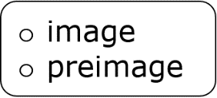
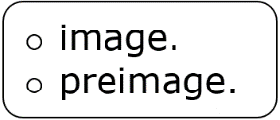
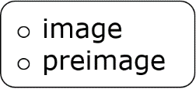


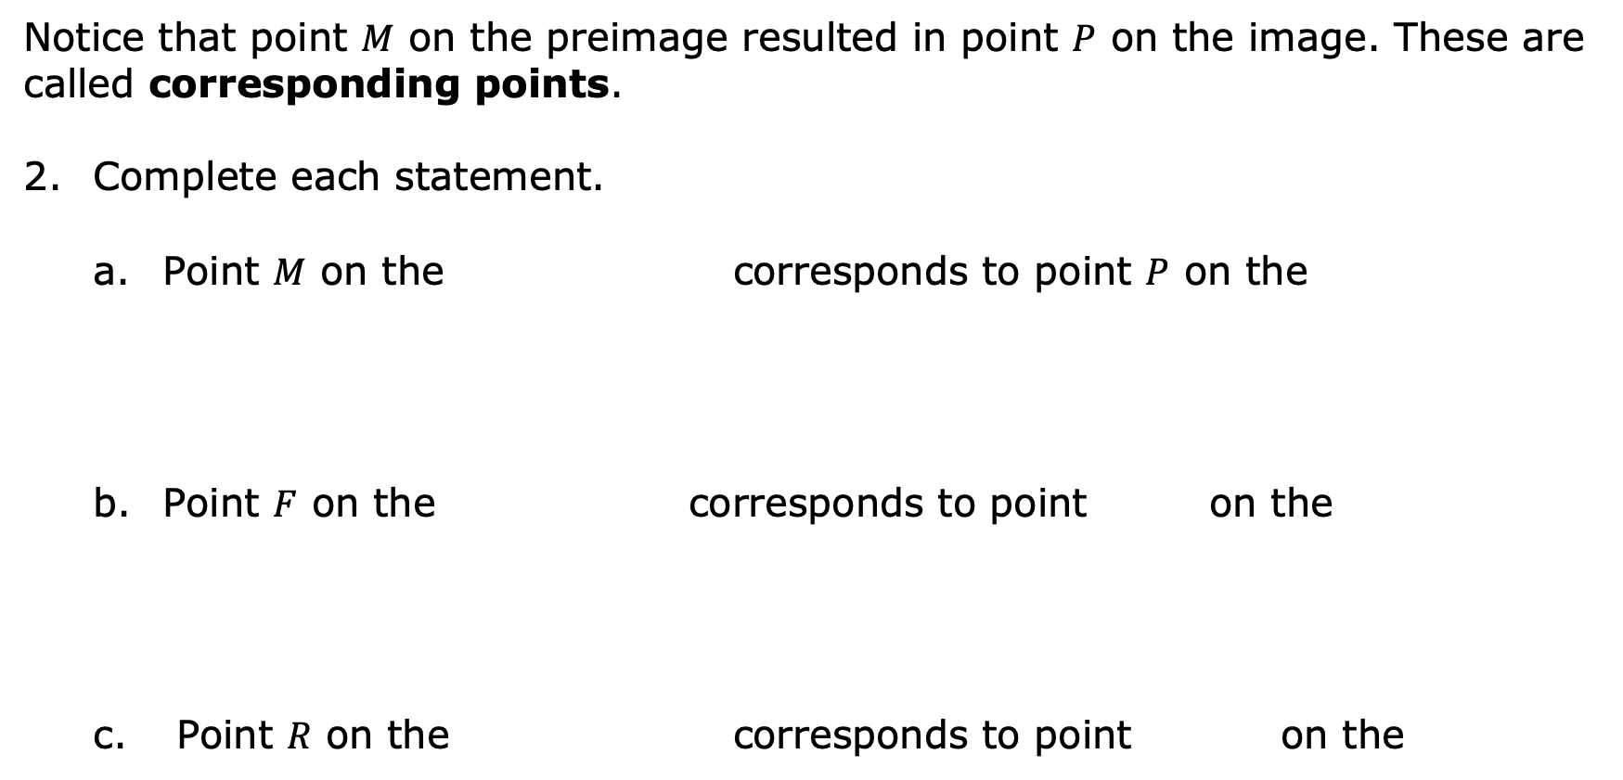
Notice that point $M$ on the preimage resulted in point $P$ on the image. These are called corresponding points.
Complete each statement.
Point $M$ on the corresponds to point $P$ on the
Point $F$ on the corresponds to point on the
Point $R$ on the corresponds to point on the
volume 2, pg. 59

Slide 16


The ray from point $M$ to point $P$ shows the movement of the preimage to the image. This is called a mapping and shows how one point is “mapped” onto another.
Draw rays on the diagram to show the mapping of points $C$ and $R$ to their corresponding points in the image.
The three rays together now show the mapping of the preimage, $∆MCR$ to the image, $∆PFN$ because all of the vertices are shown to have the same movement.
A mapping is a standardized form of showing how the preimage moves, or transforms, to the image.
volume 2, pg. 60

Slide 17

Exploration
volume 2, pg. 60

Slide 18

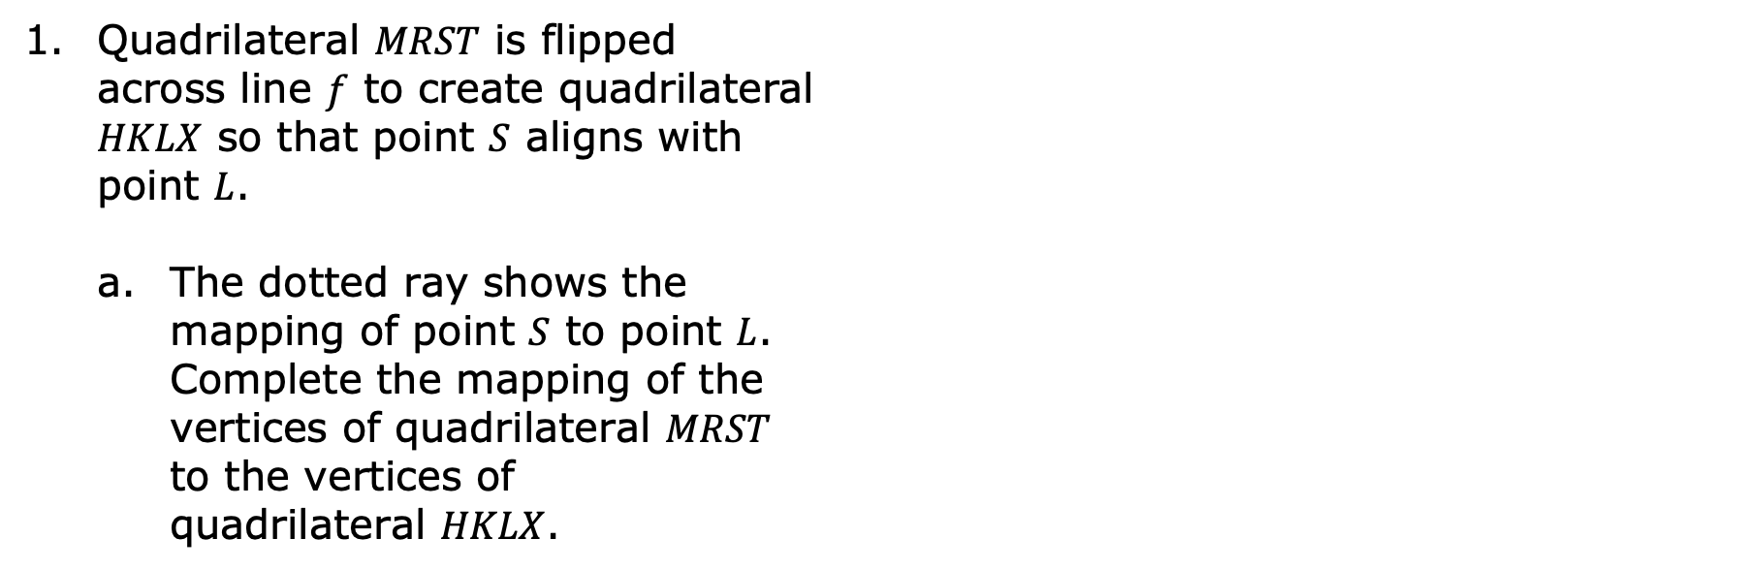
9.1.4 Exploration: Images and Preimages in Slides, Flips, and Spins
Quadrilateral $MRST$ is flipped across line $f$ to create quadrilateral $HKLX$ so that point $S$ aligns with point $L$.
The dotted ray shows the mapping of point $S$ to point $L$. Complete the mapping of the vertices of quadrilateral $MRST$ to the vertices of quadrilateral $HKLX$.
volume 2, pg. 60

Slide 19
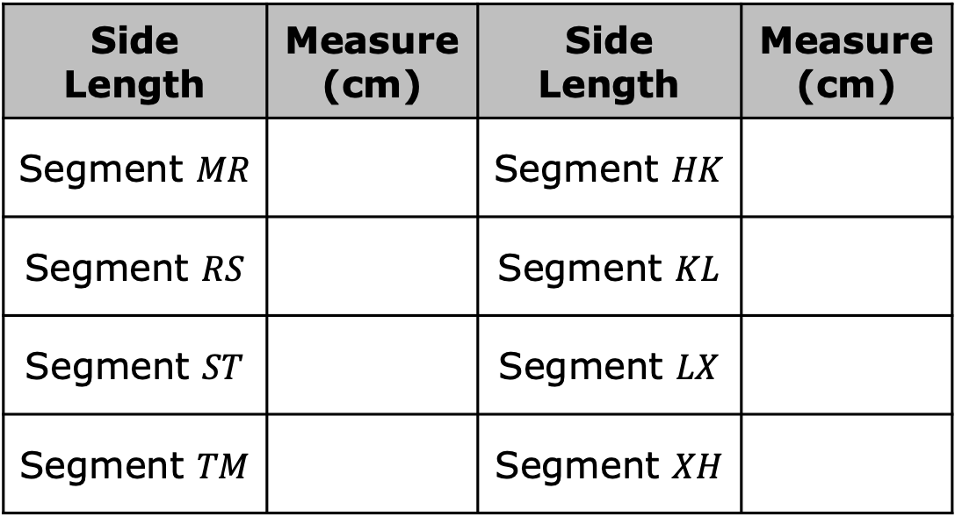
Complete the table by working with your partner to find each measure using rulers and protractors.
Side Length | Measure (cm) | Side Length | Measure (cm)
Segment $MR$ |  | Segment $HK$
Segment $RS$ |  | Segment $KL$
Segment $ST$ |  | Segment $LX$
Segment $TM$ |  | Segment $XH$
volume 2, pg. 61

Slide 20
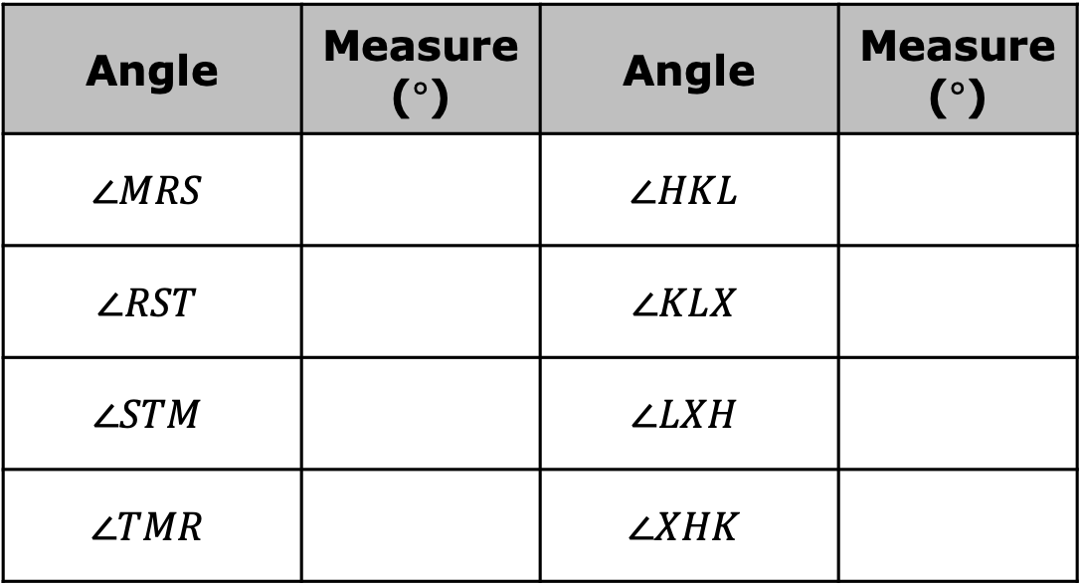
Angle | Measure ($°$) | Angle | Measure ($°$)
$$∠MRS$$ |  | $$∠HKL$$
$$∠RST$$ |  | $$∠KLX$$
$$∠STM$$ |  | $$∠LXH$$
$$∠TMR$$ |  | $$∠XHK$$
What do you notice about the side lengths and angle measures of quadrilateral $MRST$ and quadrilateral $HKLX$?
volume 2, pg. 61

Slide 21

The image, $∆NCF$, is shown after sliding the preimage, $∆WYZ$, along the dotted ray.
Complete the mapping from $∆WYZ$to $∆NCF$.
volume 2, pg. 61

Slide 22
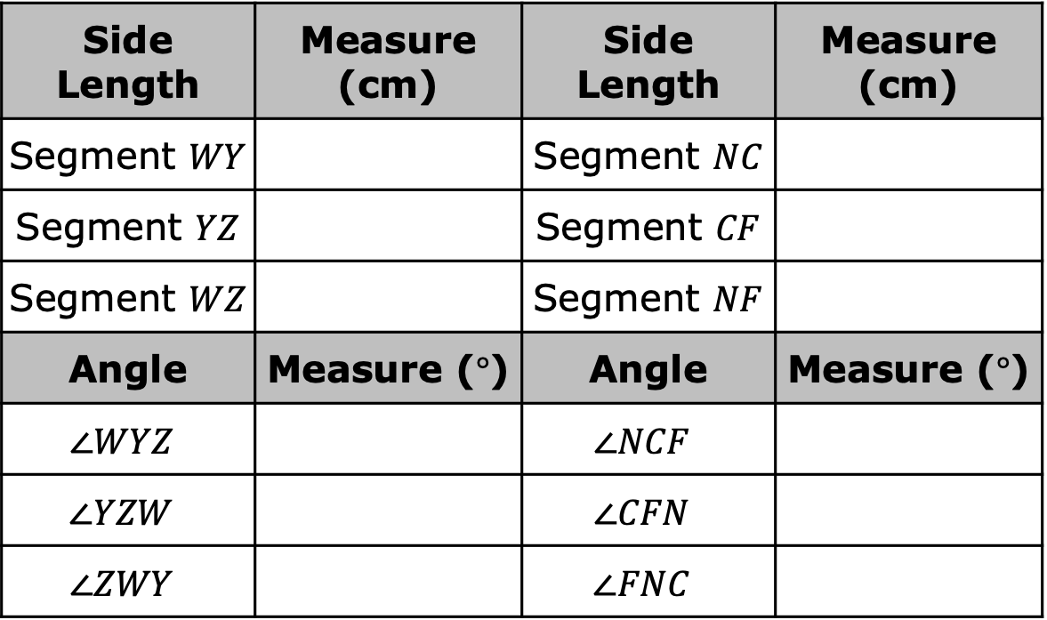

Complete the table by working with your partner to find each measure using rulers and protractors.
Discuss the relationship between the side lengths and angle measures of $∆WYZ$ and $∆NCF$ with your partner.
Side Length | Measure (cm) | Side Length | Measure (cm)
Segment $WY$ |  | Segment $NC$
Segment $YZ$ |  | Segment $CF$
Segment $WZ$ |  | Segment $NF$
Angle | Measure ($°$) | Angle | Measure ($°$)
$$∠WYZ$$ |  | $$∠NCF$$
$$∠YZW$$ |  | $$∠CFN$$
$$∠ZWY$$ |  | $$∠FNC$$
volume 2, pg. 61

Slide 23

Trapezoid $LHFB$ is spun around point $Y$ to create trapezoid $XMWP$.
The angle shown, $90°$, provides a mapping of one set of vertices for the spin. Each point on trapezoid $LHFB$ forms a $90°$ with the corresponding point on trapezoid $XMWP$ with point $Y$ as its vertex.
volume 2, pg. 62

Slide 24
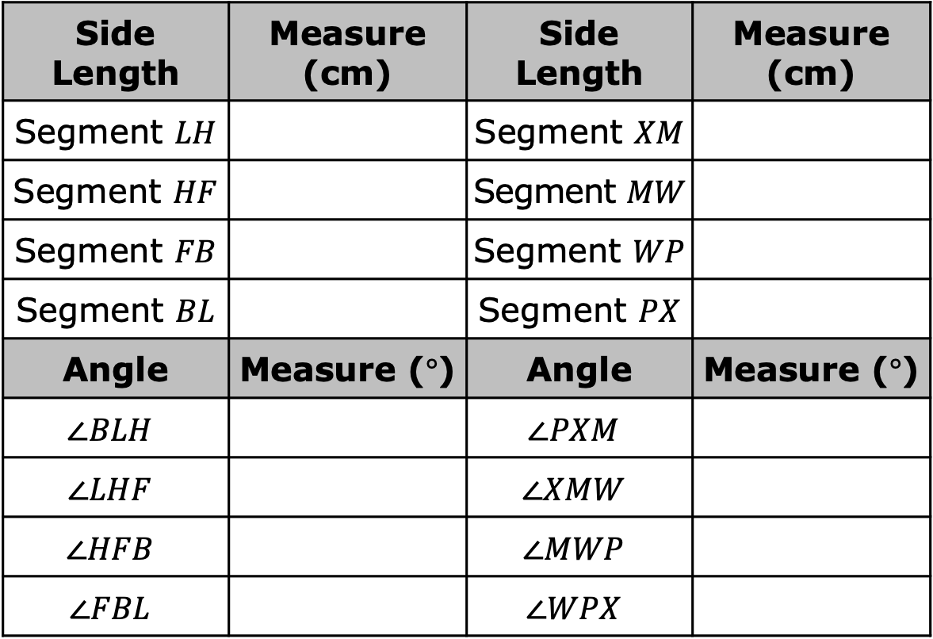
Complete the table by working with your partner to find each measure using rulers and protractors.
Side Length | Measure (cm) | Side Length | Measure (cm)
Segment $LH$ |  | Segment $XM$
Segment $HF$ |  | Segment $MW$
Segment $FB$ |  | Segment $WP$
Segment $BL$ |  | Segment $PX$
Angle | Measure ($°$) | Angle | Measure ($°$)
$$∠BLH$$ |  | $$∠PXM$$
$$∠LHF$$ |  | $$∠XMW$$
$$∠HFB$$ |  | $$∠MWP$$
$$∠FBL$$ |  | $$∠WPX$$
volume 2, pg. 62

Slide 25

Bring It Together
volume 2, pg. 62

Slide 26

9.1.5 Bring It Together: Describing the Relationship Between Figures After a Slide, Flip, or Spin
Review the three movements explored in today’s lesson – slides, flips, and spins.
Identify whether each movement preserves distance (side length) and angle measure. Complete the table below by selecting “yes” or “no” based on your observations.
Movement | Is distance (side length) preserved? | Are angle measures preserved?
Slide | Yes No | Yes No
Flip | Yes No | Yes No
Spin | Yes No | Yes No
volume 2, pg. 62

Slide 27
Figures are congruent if all corresponding parts of the figures are congruent.
Complete the statements.
When a slide, flip, or spin is performed on a figure, the
corresponding side lengths of the preimage and image the same length and the angle measures the same measure. Therefore, the preimage and image are figures.
are
are not
are
are not
congruent
similar
volume 2, pg. 63

Slide 28

Wrap-Up
volume 2, pg. 63

Slide 29
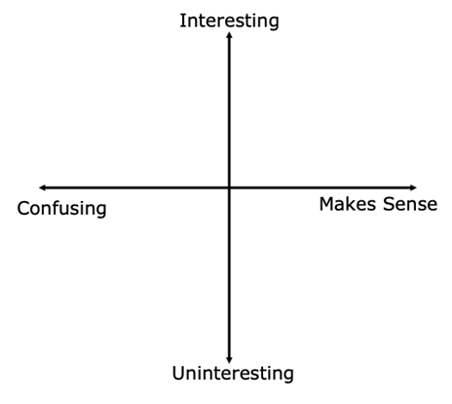
9.1.6 Wrap-Up: Reflection
Plot a point on the grid below to indicate your level of interest and how much sense you made of today’s learning targets.
I can show the mapping of a preimage to an image.
I can describe relationships between figures after a slide, flip, or spin.
volume 2, pg. 63

